Slide 1

MEDICARE 101

Slide 2

MEDICARE 101
What is
Medicare?
Medicare is a federal system of health insurance for people age 65 or older and for certain younger people with disabilities.
It pays for part of an individual's health care expenses. It is paid for through people's payroll taxes while they are working.

Slide 3

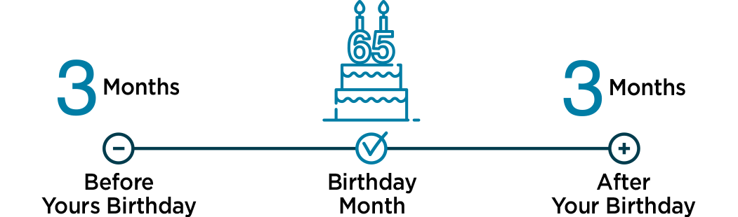
Who is eligible and when?
MEDICARE 101
People age 65 or older who have paid taxes into the program for 40 calendar quarters in their lives
People under age 65 with certain disabilities
Individuals with End-Stage Renal Disease (permanent kidney failure requiring dialysis or a transplant)
Initial
Enrollment
Period

Slide 4
What does Medicare cover?
MEDICARE 101
Part
Medicare Part A is hospital insurance.
Even when Medicare Part A covers your care:
Part
Medicare Part B is medical insurance. It may cover a wide range of items and services.
Part B deductible and/or coinsurance or copayments may apply.
A
B
  You may have to pay a deductible amount and/or coinsurance or copayment.
  There may be some services you get in a hospital or other setting that Medicare doesn’t cover.

Slide 5
What Medicare Parts A & B Cover
MEDICARE 101
Part A
Hospital and skilled nursing insurance helps cover:
Inpatient hospital care
Inpatient mental health care
Skilled nursing facility care
Home health care
Some blood for transfusions during inpatient care
Part B
Doctor’s office visit and outpatient service insurance helps cover:
Outpatient hospital services (minor surgeries)
Physician services
Some preventive care (i.e., flu and pneumonia shots)
Laboratory services
Blood
Home health care
Outpatient physical, occupational and speech-language therapy
Durable medical equipment (wheelchairs, oxygen, etc.)
Outpatient mental health
Ambulance

Slide 6
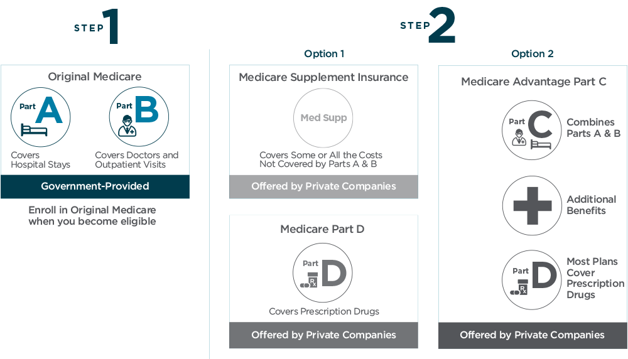
Medicare Choices
MEDICARE 101

Slide 7
Does Original Medicare cost anything?
MEDICARE 101
In some cases, switching from employer-sponsored insurance to Medicare costs less and adds more coverage.
Part
Part
A
B
There is typically no monthly premium for Medicare Part A if an individual or their spouse have paid for it through payroll taxes while working.
Most people pay a monthly premium for Part B, which is based on your household income.
Medicare Supplement Plans, Medicare Advantage Plans and Part D drug plans may cost extra.

Slide 8
Medicare Costs – Part B Premium
MEDICARE 101
FILE INDIVIDUAL TAX RETURN | FILE JOINT TAX RETURN | FILE MARRIED & SEPARATE TAX RETURN | YOU PAY EACH MONTH (IN 2022)
$91,000 or less | $182,000 or less | $91,000 or less | $170.10
$91,001 to $114,000 | $182,001 to $228,000 | Not Applicable | $238.10
$114,001 to $142,000 | $228,001 to $284,000 | Not Applicable | $340.20
$142,001 to $170,000 | $284,001 to $340,000 | Not Applicable | $442.30
$170,001 to $500,000 | $340,001 to $750,000 | $91,000 to $409,000 | $544.30
$500,000+ | $750,000+ | $409,000+ | $578.30

Slide 9
Samples of Medicare Costs – Care under Part A
MEDICARE 101
Hospital and Skilled Nursing Insurance
SERVICE
Hospitalization
Skilled Nursing Facility Care
MEDICARE PAYS | YOUR COST SHARE
Days 1–60 — All but $1,556 | $1,556
Days 61–90 All but $389 per day | $389 per day
Days 91–150 (Lifetime Reserve Days) All but $778 per day | $778 per day
Nothing beyond 150 days (After using Lifetime Reserve Days) | All costs for the remainder of the hospital stay
First 3 pints of blood – $0 | 100%
Days 1–20 100% of approved amount | Nothing
Days 21–100 All but $194.50 per day | $194.50 per day
Days 100+ — No benefit | All costs for the remainder of your stay

Slide 10

Samples of Medicare Costs – Care under Part B
MEDICARE 101
Doctor’s Office Visit and Outpatient Service Insurance
SERVICE
Medical Expenses Outpatient, Doctor Visits, Specialist
MEDICARE PAYS | YOUR COST SHARE
80% of the approved amount | 20% of the approved amount $233 deductible per calendar year
    These costs are in addition to the monthly Medicare Part B premium, which you will need to pay. A Medicare supplement plan may help cover some or all of these costs.

Slide 11

Medicare Supplement
MEDICARE 101
VS
Medicare Advantage

Slide 12
Medicare Choices
MEDICARE 101

Slide 13


Medicare
Supplement
MEDICARE 101
You’re eligible if you are :
01
02
Enrolled in Medicare Parts A and B at the time your coverage begins
A resident of the state in which you are applying for coverage
03
Age 65 or older (or under age 65 with certain disabilities in some states)
If you are eligible for Medicare due to End-Stage Renal Disease (ESRD),
please review the Choosing a Medigap Policy: A Guide to Health Insurance for People with Medicare for eligibility information.

Slide 14

Medicare Supplement Plans
MEDICARE 101
Private health insurance plans for people on Medicare Parts A and B who want help paying some of the health care costs not covered – like coinsurance, copayments and deductibles.
Plans are named with letters of the alphabet (A, B, C, D, F, G, K, L, M and N), and benefit levels vary by plan.
Typically, the more comprehensive the coverage, the higher the monthly premium for the Medicare Supplement Plan.

Slide 15
Medicare Supplement Insurance (MEDIGAP) Plans
BENEFITS | A | B | C | D | F | G | K | L | M | N
Medicare Part A coinsurance and hospital costs (up to an additional 365 days after Medicare benefits are used) | 100% | 100% | 100% | 100% | 100% | 100% | 100% | 100% | 100% | 100%
Medicare Part B coinsurance or copayment | 100% | 100% | 100% | 100% | 100% | 100% | 50% | 75% | 100% | 100%
Blood (first 3 pints) | 100% | 100% | 100% | 100% | 100% | 100% | 50% | 75% | 100% | 100%
Part A hospice care or coinsurance copayment | 100% | 100% | 100% | 100% | 100% | 100% | 50% | 75% | 100% | 100%
Skilled nursing facility care coinsurance |  |  | 100% | 100% | 100% | 100% | 50% | 75% | 100% | 100%
Part A deductible |  | 100% | 100% | 100% | 100% | 100% | 50% | 75% | 50% | 100%
Part B deductible |  |  | 100% |  | 100%
Part B excess charges |  |  |  |  | 100% | 100%
Foreign travel emergency (up to plan limits) |  |  | 80% | 80% | 80% | 80% |  |  | 80% | 80%
MEDICARE 101
Out-of-pocket limit in 2022
$6,620 | $3,310

Slide 16
Enrollment Eligibility
MEDICARE 101
Open Enrollment
Enrollment within 6 months of your Medicare Part B coverage
Guaranteed Issue
Enrollment within 60 days of loss of other health coverage
Medicare Supplement Plan
Medical Underwriting
Moving from one Supplemental plan to another
Would apply if no other health insurance coverage exists within prior 60 days
Applies if Part B is beyond 6 months and no other health insurance

Slide 17

Medicare Advantage (Part C)
MEDICARE 101
All-inclusive private insurance plan
Replaces Original Medicare (Parts A and B)
  Not losing Parts A and B
  Must continue to pay Part B premium
Benefits and services equal to or better than Original Medicare
  Often includes Rx, Dental, Vision and other value-added benefits
Monthly premium
($0 premium plans often available)
Deductibles, copayments and/or coinsurance vary by plan

Slide 18

What is Medicare Part D?
MEDICARE 101
01
Combined into a Medicare Advantage Prescription Drug (MAPD) plan
It’s Medicare Prescription Drug coverage you get in one of two ways.
02
A stand-alone Prescription Drug Plan (PDP), often combined with a Medicare Supplement plan

Slide 19
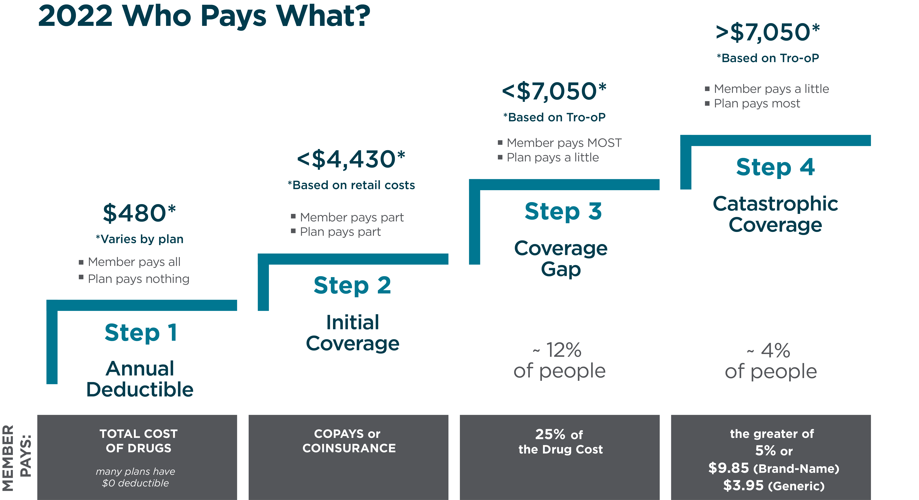
Part D
MEDICARE 101
Prescription Coverage

Slide 20
Your Part D Premium Goes Up With Income
MEDICARE 101
FILE INDIVIDUAL TAX RETURN | FILE JOINT TAX RETURN | FILE MARRIED & SEPARATE TAX RETURN | YOU PAY EACH MONTH (IN 2022)
$91,000 or less | $182,000 or less | $91,000 or less | Your plan premium
$91,001 to $114,000 | $182,001 to $228,000 | Not Applicable | $12.40 + your plan premium
$114,001 to $142,000 | $228,001 to $284,000 | Not Applicable | $32.10 + your plan premium
$142,001 to $170,000 | $284,001 to $340,000 | Not Applicable | $51.70 + your plan premium
$170,001 to $500,000 | $340,001 to $750,000 | $91,000 to $409,000 | $71.30 + your plan premium
$500,000+ | $750,000+ | $409,000+ | $77.90 + your plan premium

Slide 21
What should I be doing and when?
MEDICARE 101
Employer coverage and over 65
Employer coverage and turning 65
If you will not automatically be enrolled, you should sign up for Part A when you’re first eligible even if you have existing coverage through an employer—this is because Medicare Part A is free for most people.
If a beneficiary has an HSA account, they should not sign up for A or B. If they want to sign up for A or B, they must stop contributing to their HSA 6 months prior to obtaining A or B.
Most people who are still working and are covered under their employer plan do not need additional coverage.
If the employer has fewer than 20 employees, you should sign up for Part A and Part B when you’re first eligible.
If the employer has 20 or more employees, you may be able to delay Part A and Part B.

Slide 22
What should I be doing and when?
MEDICARE 101
Other coverage or no coverage and turning 65
No coverage and over 65
In most cases, if you are receiving benefits from Social Security, you will automatically get Part A and Part B when you turn 65.
If you are over age 65, don’t have Part A and B, and missed your initial enrollment, you can sign up from January 1st to March 31st and your coverage will begin July of the same year (you will incur a late enrollment penalty in this scenario).

Slide 23
The Size of Your Group Matters
MEDICARE 101
Less Than
Less Than
All
20
20
100
Employees
or more Employees
Employees
Group Sizes
Any Medicare-eligible employee (or spouse / dependent) MUST enroll in
Medicare, because by law Medicare becomes the primary coverage. If the individual does not enroll into Medicare, claims may not be paid, and they may face financial penalties due to late enrollment.
If you are currently working and coverage is through a credible employer plan, you (or spouse) may be able to delay Part A and Part B.
If you (or spouse / dependent) qualifies for Medicare due to a disability, Medicare would be considered as your primary coverage.
If your prescription drug plan is not considered creditable coverage, you may face
a financial penalty after retirement. We recommend you consult your employer about creditable coverage.

Slide 24
COBRA VS MEDICARE RULES
MEDICARE 101
Supreme Court Ruling Geissal
vs
Moore of 1994
Generally, Medicare is primary once the member elects COBRA
Please note, an actively working employee
says persons eligible or enrolled in Medicare on the day of the qualifying event must be offered COBRA. Conversely, COBRA coverage will end when a person becomes eligible or enrolled in Medicare while being covered under COBRA.
The exception to this is when the individual is eligible for Medicare due
to End Stage Renal Disease (ESRD). In these situations, the group plan is
primary for the first 30 months of the disability whether the person is on the group health plan as an employee, a dependent or on COBRA continuation.
who voluntarily terminates off the group plan to fully go onto Medicare is not a COBRA qualifying event for the spouse and/or dependent(s) as the event of Medicare entitlement does not cause a loss of coverage.
*NOTE: You may be able to keep COBRA coverage for services that Medicare does not cover such as COBRA dental, vision, etc. The insurance company that provides your COBRA coverage may allow you to drop your medical coverage but keep paying a premium for the additional coverage for as long as you are entitled to COBRA. Contact your plan for more information.*

Slide 25

There are penalties for getting it wrong
MEDICARE 101
Late Enrollment Fees
Part
  is 10% for every 12 months you didn’t sign up
B
Part
  is 1% of the average Prescription Drug Plan Part D premium per month you didn’t sign up
D

Slide 26

What about my dependents that are on my company’s coverage?
MEDICARE 101
If you have dependents on your company’s plan, you can remain on that plan.
If you obtain a Medicare plan, your dependents would have to obtain individual coverage.

Slide 27


FAQs on Coverage
MEDICARE 101
Can I see my own doctors?
If you choose a Medicare Advantage plan, you may have network restrictions that limit your health care provider choices.
Certain plans may also require you to choose a primary care physician (PCP) to coordinate your care.
Check to make sure your current doctors will accept the new plan you are considering enrolling in.
Are my drugs covered?
Refer to each plan’s formulary for a complete list covered drugs.
Medicare By Savoy can research this for you

Slide 28
When Can I Sign Up or Switch Coverage?
MEDICARE 101
 | Initial Enrollment Period (IEP) | General Enrollment Period (GEP) | Special Enrollment Period (SEP) | Annual Enrollment Period (AEP) | Open Enrollment Period (OEP)
Who Needs | Turning 65 | Missed Initial Enrollment Period | Previous Employer-based Coverage | Medicare Plan Enrollees | Medicare Advantage (MA) Enrollees
Purpose | Enroll in Original Medicare | Enroll in Medicare Part A or Part B | Enroll in Medicare Part A or Part B | Reevaluate coverage & Make Changes | One-time change to MA Plan
When | 3 months before 65th birthday through 3 months after | January 1 – March 31 | 8 months from termination of employer coverage | October 15 – December 7 | January 1 – March 31

Slide 29






How can a broker help me with this transition?
MEDICARE 101
As an independent broker, Medicare By Savoy works with multiple health insurance carriers, making it easy for us to match you with the plan that lines up best with what you’re looking for – from benefits to budget! All at no additional cost to you.
Provide complimentary step-by-step guidance
Compare plans from different companies for you
Understand the cost
Avoid mistakes and penalties
Help you enroll and have coverage when you need it
Offer better privacy than online sales sites

Slide 30
When should I engage with a broker?
MEDICARE 101
If turning 65, you should start talking about your options 6 months before your 65th birthday.
If you will be losing coverage through your employer and are already 65 or older, you should contact a broker immediately for guidance.
If considering Medicare but you have dependents on your current plan, a qualified broker can help everyone involved through the transition.

Slide 31
How is my employer involved?
MEDICARE 101
Coordinates transition dates with you
Makes any necessary changes to your payroll deduction for health insurance.
Your employer
Can put you in touch with Medicare By Savoy

Slide 32
Q&A

Slide 33

Speak to a licensed Medicare Expert.
MEDICARE 101
Angie Wilson
Account Manager, Consumer and Senior Markets
angiewilson@savoyassociates.com
609.361.4028
Mon – Fri: 9AM – 5PM

Slide 34
THANK YOU
11.22.2021

